Slide 1
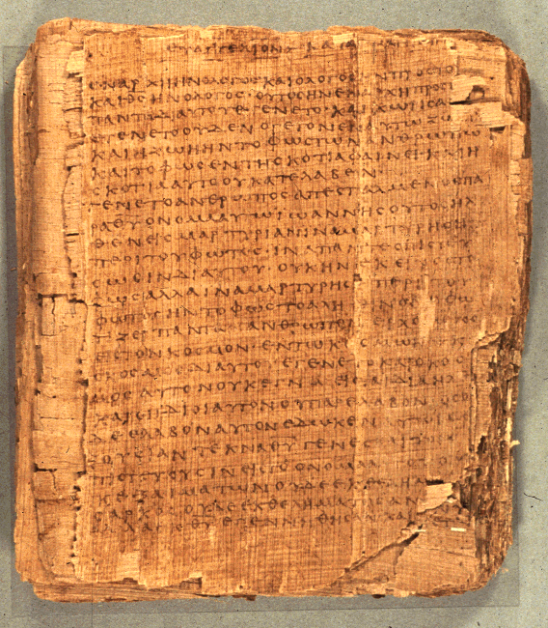
Comprehending the Psalms
Dr. Rodney K. Duke

Slide 2
CLASS 4
Assign:
Daily Journal
Assign. #6. Outline AND diagram the balanced thought structure of Ps 24.
Assign. #7. Discover the various roles of the Israelite priests. (Long reading on priests, if interested)
Day Objectives:
Explain the cultic symbol system behind the sacrificial system.
Learn how to diagram “balanced thought structures.”
Develop skill outlining psalm types.

Slide 3
JOURNAL THOUGHTS & OBSERVATIONS

Slide 4
REVIEW: IDENTIFYING TYPES OF PSALMS (Assign, #2)
Psalms of Petition/Lamant (Pss 74, 79)
Intention: Get God to act
Addressed to God
Mood shifts from lament/despair to confidence [except Ps 88]
Time orientation: present
Psalms of Declarative Praise/Thanksigiving (Pss 34, 116)
Intention: Thanking God
Addressee: God, general audience, sometimes oneself
Mood consistent: upbeat
Time orientation: reflects back on past
Psalms of Descriptive Praise/Hymns (Pss 33, 113)
Intention: Praise God in general
Addressed to general audience
Mood consistent: upbeat
Time orientation: rather atemporal
Note: Two major naming systems used by commentators.

Slide 5
REVIEW: BACKGROUND ON PSALMS
Theological Basis and/or Implications
Each psalm has own distinct message; but some generalizations:
A. Petitions:
1. God is to be approached boldly, with complete openness
2. Even in despair, the psalmist expressed trust
[“… by prayer and petition, with thanksgiving, present your requests to God” (Phil. 4:6b NIV)]
B. Thanksgivings:
1. God is to be thanked by testimony before the community in celebration
2. God is experientially knowable
3. Faith in God who acts on their behalf
C. Hymns:
1. God is worthy of praise
2. God, who is majestic and sovereign, graciously condescends to care for those who trust God

Slide 6
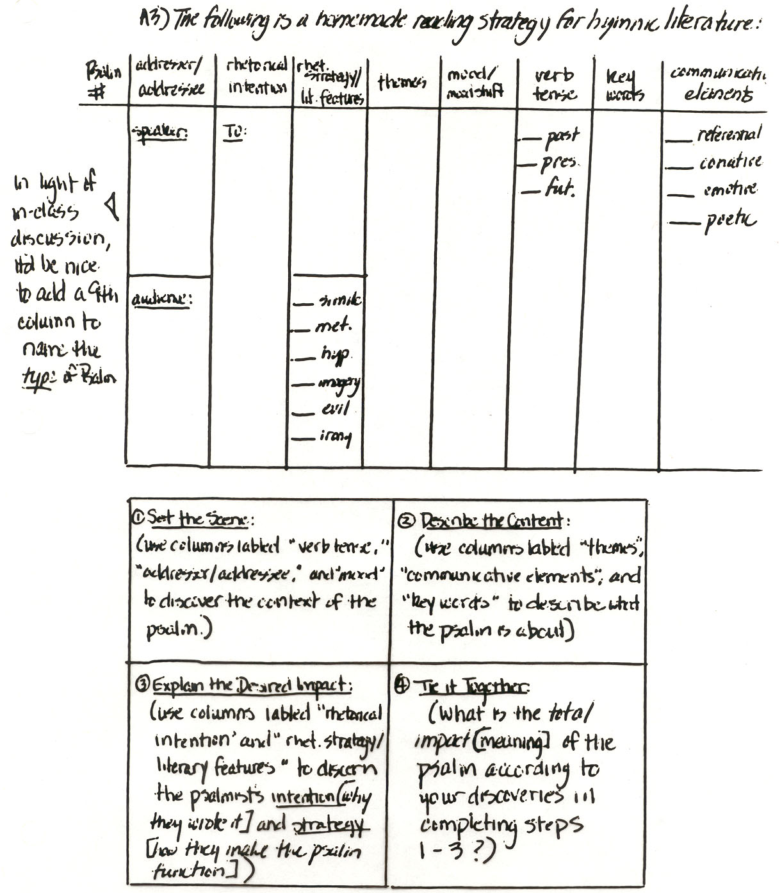
Sample of work on Assign. 3, Reading Strategy
See Handouts, p. 29, will go over next class.

Slide 7
SYMBOL SYSTEM OF THE PSALMS
HOLINESS
SACRIFICIAL SYSTEM
PRIESTS (see PDF link at course site)

Slide 8
Holiness & Sacrifices
(relates to Handouts, pp. 16-17)
What are some “unclean” foods in our culture that might be eaten in other cultures? Why are they “unclean” in our culture?
What are some “unclean”/unacceptable behaviors in our culture that might be acceptable in other cultures? Why are they unacceptable?
For the Israelites fish were “clean” but lobsters were “unclean.” What would be a possible explanation?
For Israel blood from a cut was “clean” but menstrual blood was “unclean.” What would be a possible explanation?

Slide 9

Holiness & Sacrifices
a. Purity system and Holiness system
Purity: clean (life, order) vs. unclean (death, chaos)
Holiness: holy (set apart for sacred use) vs. common
Normal (clean and common) vs “Contagious” (unclean, holy)
Holiness has “gradations” (examples on next slide)
b. Purification:
Permitted impurity (not sin) vs. unpermitted
Unpermitted impurity polluted God’s “dwelling place”

Slide 10
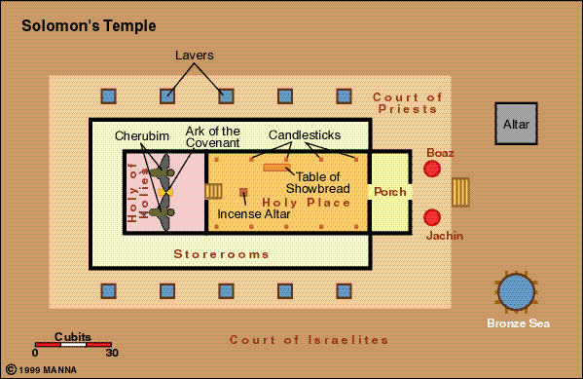

Slide 11
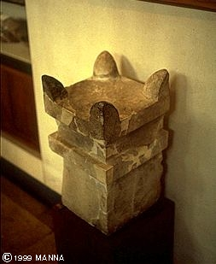
Holiness & Sacrifices
c. Sacrificial system:
Gifts or gestures of obedience, but NOT food or magical manipulation
Blood (Lev. 17:10-14): symbol of life
A couple of types:
“Purgation”: cleansed God’s dwelling
“Well-being”: feast (“Thanks offering”; (Todah: thanks; thanks offering)
Horned altar from Megiddo

Slide 12
PSALM 54 (Assign. 5) Type: ?
Psalm of Lament/Petition
1) O God, by Your name save me, And by Your power vindicate me!
2) O God, hear my prayer, Give ear to the words of my mouth!
3) For strangers have arisen against me, And terrifying ones seek my life; Men who do not set God before them.

Slide 13
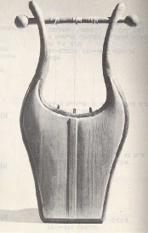
PSALM 54 (2 of 2)
4) Behold, God [is] the One who helps me, My Lord [is] the One who upholds my life.
5) May He return evil to those lurking for me, In Your faithfulness bring them to an end.
6) With a free-will offering I will sacrifice to You, I will thank Your name, Yahweh, because [it is] good.
7) Because from every trouble You have delivered me, And against my enemies my eye has gloated.

Slide 14
PSALM 54 (simple outline)
A. Petition for oneself: deliverance (vv. 1-2)
B. Lament: persecuted by enemies (v. 3)
C. Trust: God is the one who helps (v. 4)
D. Petition against the enemy: destroy (v. 5)
E. Trust (vv 6, 7) [Closing formula]
1. Vow of thanksgiving (v. 6)
2. Declarative praise (as if already delivered) (v. 7)

Slide 15
DIAGRAMMING “BALANCED THOUGHT STRUCTURES”
(After class, please read Handouts, pp. 24-25)
PSALM 54 (1 of 2)
PETITION (1-2)
O God, by Your name save me, And by Your power vindicate me!
O God, hear my prayer, Give ear to the words of my mouth!
LAMENT (3)
For strangers have arisen against me, And terrifying ones seek my life; Men who do not set God before them.
Notes:
Note that verses 1 and 2 (petitions) have the same thought structure which is different from the lament (3), such that this different “rhythm” helps to distinguish one section from the next.
Add to your notes: Most people call this poetic device “parallelism” and simply labelled different “types” of parallelism: synonymous, antithetical, or synthetic (no play on words). Those categories are too simplistic. Start with identifying/diagramming the balancing elements and then look for any kind of relationship or development between them. For example, most “synonymous” parallelism shows movement to greater specificity. This is true even in Hebrew statements. Here is a Yiddish-style example: A great dancer is he, that boy, David. ☺

Slide 16
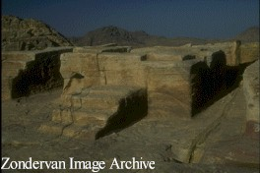
PSALM 54 (2 of 2)
TRUST (4)
Behold, God [is] the One who helps me, My Lord [is] the One who upholds my life.
PETITION (5)
May He return evil to those lurking for me, In Your faithfulness bring to an end them.
TRUST: with Vow of Praise (6) and Descriptive Praise (7)
With a free-will offering I will sacrifice to You, I will thank Your name, Yahweh, because [it is] good.
Because from every trouble You have delivered me, And against my enemies my eye has gloated.
High Place Altar
Notes:
Note:
1) Again, the pattern/rhythm changed from the trust section (4) to petition section (5).
2) The petition pattern (v 5) A B C A B has a statement of motivation (C: in your faithfulness) “sandwiched” in the middle.
3) The vow of praise (v 6) has a “stairstep” or building pattern (A B, B C). This is a useful pattern in proverbs and suggests there could be further develop. Made up example:
God is good | to the righteous (A B)
to the pure in heart | who seek God (B C)
to those who turn to God | for guidance. (C D)

Slide 17
PSALMS OF THANKING AND THE TODAH SACRIFICE
Hebrew todah: “acknowledgment” is also technical term for the thanksgiving sacrifice, a type of peace offering
"'This is the law of the peace offering sacrifice which he is to present to the LORD. ¹² If he presents it on account of thanksgiving, along with the thank offering sacrifice he must present unleavened loaves mixed with olive oil, unleavened wafers smeared with olive oil, and well soaked ring-shaped loaves made of choice wheat flour mixed with olive oil. ¹³ He must present this grain offering in addition to ring-shaped loaves of leavened bread which regularly accompany the sacrifice of his thanksgiving peace offering. ¹⁴ He must present one of each kind of grain offering as a contribution offering to the LORD; it belongs to the priest who splashes the blood of the peace offering. ¹⁵ The meat of his thanksgiving peace offering must be eaten on the day of his offering; he must not set any of it aside until morning” (Lev. 7:11-15, NET)
Notes:
Note to self: Added after the Class 3 met, so included here with Class 4, but have added now at new Class 3 slides

Slide 18
PSALM 32 (1 of 2)
(Individual Thanksgiving/Declarative Praise)
I. Opening Proclamation, 1-2 (Based on what the psalmist has learned: blessed is the one who is forgiven.)
A. Rebellion forgiven/lifted (personal/subjective)
B. Guilt covered (objective)
C. Sin not reckoned against (objective)
D. In his spirit no deceit (personal/subjective)
ABBA
II.Report of Deliverance, 3-5
A. Trial, 3-4
1. I: wasting away due to unconfessed sin, 3
2. God: hand was heavy (causing affliction), 4a
3. I: strength dried up, 4b
ABA
B. Cry to God: acknowledged/confessed sin, 5ab
C. Deliverance: received forgiveness, 5c
Notes:
A good outline would have at least as much information as this one that: 1) shows the flow of thought through the outlines levels and sublevels (I. ABCD, etc.) and 2) gives brief, descriptive summaries of each verse.
Remember: these psalms were part of an extended “ritual” of making a pilgrimage to Jerusalem, celebrating a Todah (thanksgiving) meal together, and testifying to the people gather around the Temple area about what God did in the psalmist’s life.
The “heart” of such psalms are the “Report of Deliverance” section that reflect back on the past to a need and to God’s deliverance.
On the slide, next to the outline proper, I have added more observations about some the patterns of balanced thought structures. For instance, under Section I. ABCD, there is a thought pattern that reflects on the nature of “sin” from the personal perspective (the two blue A’s) as inner rebellion and inner deceit, and in terms of objective qualities (the two green letters) as tangible guilt that pollutes and must be “covered” (atoned) and as a debt to be “reckoned” (an accounting term).

Slide 19
PSALM 32 (2 of 2)
(Individual Thanksgiving/Declarative Praise)
III. Conclusion: Instruction & Affirmation, 6-11
A. Command: pray to God, 6
B. Affirmation: God will deliver, 7
C. Intention to instruct, 8
D. Instruction: do not be without understanding, 9
E . Affirmation: Yahweh loves those who trust Him, 10
F. Command: praise God, 11
ABCCBA
Notes:
In the “Conclusion” the psalmist turns to application by addressing his audience and instructing them on the basis of what he learned.
The pattern that I find in this section is difficult to see, and you might question that the pattern is in the eye of the beholder. It is legitimate to be cautious about seeing patterns everywhere. However, this is how ancient psalmists structured material; so, it is on track to look for thought patterns.
This form critical analysis sheds light on the psalm. When it was read “Christologically” people thought of the speaker of verses 8-9 as Jesus or God speaking. When we put this psalm in the context of a thanksgiving meal and testimony being cared out at the Temple, then it makes sense to see verses 8-9 as the psalmist instructing the people around him: “Don’t be as stubborn as a mule, like I was. Humble yourself to seek God, and God will forgive/deliver you.”
Note: in the next psalm, I will make a point about God’s “love” (chesed).

Slide 20
Psalm 33 (1 of 2)
(abbreviated outline)
“love” – chesed
Covenant faithfulness
I. Call to Praise 1-3 [chiasm: sing, praise, sing]
II. Cause for Praise 4-19 [themes: word, deed, love]
A. Summary: God’s attributes 4-5
B. Illustrations: Yahweh’s word and deed 6-12
1. Sovereign over creation 6-9
a. Act of creation 6-7
b. Implication (“therefore”) 8-9
2. Sovereign over history 10-12
a. Actions among nations 10-11
b. Implication 12
C. Illustration: Yahweh’s justice and love 13-19
1. Position of sovereignty over world: knows all 13-15
2. Intervenes in world with justice and love 16-19
Notes:
The outline of the psalm on these slides is abbreviated because I wanted to show the overarching structure on just a couple of slides. Your outlines, hopefully, include more detail.
The main flow of thought to look for in the “Cause to Praise” section of this type of psalm is how there is a movement from God’s supremacy and sovereignty (often expressed spatially in terms of God being above and looking down) to God’s self humility (the fact that the Creator of the cosmos gets involved in the lives of nations and even in the lives of individuals).
Just like a literary analysis of any poetic work, your observations should include key themes, repeated motifs and words, as well as looking for graphic language and figures of speech – as we did with proverbs. In this psalm, some key themes have to do with God’s word (creative and firm), God’s deed’s, and God’s “love.”
Note: the Hebrew word for “love” used in this psalm is “chesed.” It means covenant, pledged, loyal love; that is, an act of will to remain faithful to the relationship. “Love” has become a poor translation for chesed, since in our culture “love” is something that people believe they “fall into” or “fall out of.” Therefore, modern translators will sometimes translate chesed with phrases, such as “covenant love,” or “steadfast love.” [If you are familiar with old marriage vows, they used to use an old English word “troth” that would be a good equivalent for chesed, in the vow, “I pledge you my troth.”]

Slide 21
Psalm 33 (2 of 2)
III. Conclusion: statement of faith 20-22
A. Wait for Yahweh 20
B. Rejoice in Yahweh 21
C. Petition Yahweh in trust 22

Slide 22
Assignment #6
6. Objective: Develop skill of identifying the “balanced thought structures” (parallelism) of Hebrew poetry.
In the handout, study the pages on “Balanced Thought Structures.” (pp. 24-25)
Using the handout translation of Psalm 24 (p. 27), outline major parts of the psalm. (Come up with your own headings. This psalm does not fit one of the 3 major types.)
Using the handout translation of Psalm 24 (p. 27), diagram with letters and slash lines, verse-by-verse, each of the balanced units in Psalm 24.

Slide 23
Purposes of Creating an Outline
I. Main summary
A. Summary
1. sum
2. sum
B. Summary
II. Main summary
Etc.
1) Outline structure: gives overview of flow of thought / syntactic level
2) Outline labels: function as summaries & give overview of content / semantic level

